Slide 1
Kinetic Particle Model

Slide 2
States of Matter
Matter can exist in 4 states
Solid
Liquid
Gas
Plasma (we are not looking at this yet)
We use the kinetic particle model to explain the properties of these different states

Slide 3
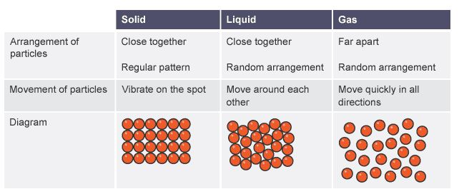

Slide 4
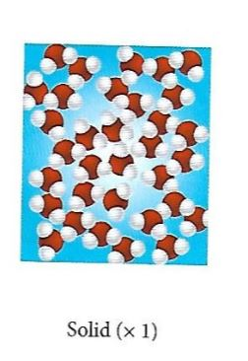
Solids
PROPERTIES | EXPLANATION
They have a fixed shape and cannot flow | The particles cannot move
The cannot be compressed | The particles are close and have no space to move into

Slide 5
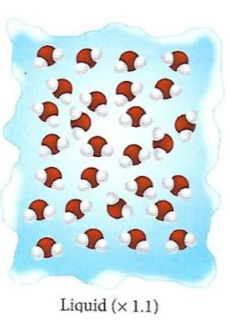
Liquids
PROPERTIES | EXPLANATION
They flow and take the shape of their container | The particles are free to move around each other
The cannot be compressed | The particles are close together and have no space to move into

Slide 6
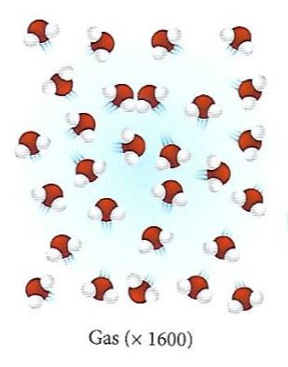
Gases
PROPERTIES | EXPLANATION
They flow and fill their container | The particles can move quickly and freely in all direction
The can be compressed | The particles are far apart and have space to move into

Slide 7
Energy in these states
The particles in all of these states have both kinetic and potential energies.
The potential energies are in the bonds that attach the particles to each other. These behave like springs. There is an ideal length, but can be stretched or compressed. This is strongest in solids, less so in liquids. There is negligible potential energy associated with gases.
The kinetic energy is from the movement of the particles. In solids, there is still kinetic energy, from the vibration of the particles.

Slide 8
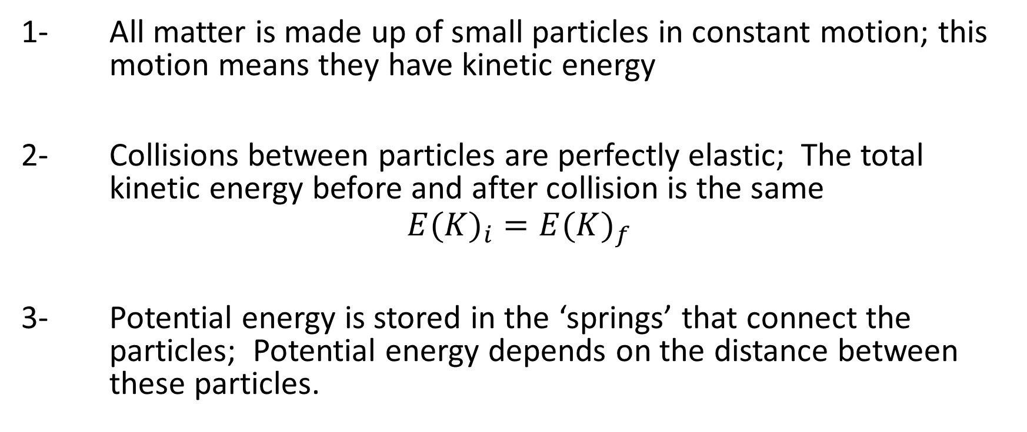
Assumptions of the kinetic particle model
1- All matter is made up of small particles in constant motion; this motion means they have kinetic energy
2- Collisions between particles are perfectly elastic; The total kinetic energy before and after collision is the same
$${E(K)}_{i}={E(K)}_{f}$$
3- Potential energy is stored in the ‘springs’ that connect the particles; Potential energy depends on the distance between these particles.

Slide 9
What is heat?
Heat is the total energy of a substance due to the movement of its particles.
What is Temperature?
Temperature is a measure of the average kinetic energy of the particles in a body.

Slide 10
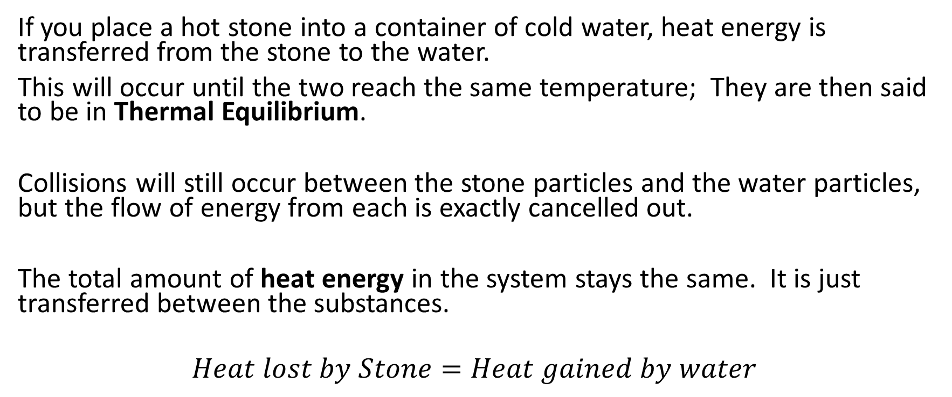
Thermal Equilibrium
If you place a hot stone into a container of cold water, heat energy is transferred from the stone to the water.
This will occur until the two reach the same temperature; They are then said to be in Thermal Equilibrium.
Collisions will still occur between the stone particles and the water particles, but the flow of energy from each is exactly cancelled out.
The total amount of heat energy in the system stays the same. It is just transferred between the substances.
$$Heat lost by Stone=Heat gained by water$$

Slide 11
Describe the flow of energy when you put an ice cube in a warm drink.

